Slide 1

Samantha Ahern, Digital Education Developments

Slide 2
My involvement with Open
Carpentries.org
  Carpentries Instructor
  Code of Conduct Committee Member
Mozilla Open Leaders
  Completed Open Leadership program in Autumn 2017 (Cohort 4)
  Coach – 2017 Mozilla Global Sprint
  Mentor – Open Leaders program Autumn 2018 (Cohort 8)
OER19
  Member of the organising committee
Notes:
I am an instructor for the Carpentries.org and am a member of the code of conduct committee
Have completed Mozilla Open Leadership training and am a mentor for Cohort 6 of the open leadership program
As part of my role I develop OER, presented about this work at the OER18 conference and am part of the organising committee for OER19

Slide 3

What does Open mean to me?
https://youtu.be/quKdaqlR_9w?t=134
Notes:
My views on what open means are similar to that of Mozilla, however I am a bit more pragmatic about licensing and will use more restrictive licenses than CC0

Slide 4
Open for All?
Algorithm deems The Sun easiest tabloid to read, comparable to CBBC
“The readability scores of the articles also indicated that online tabloid newspapers were more readable than broadsheets, and they were more likely to employ sentimental language than their highbrow media fellows. In a case study of 15 leading newspapers from the US and the UK, The Sun was found to be the easiest to read (with a readability score similar CBBC's Newsround), while The Guardian was scored as the least readable.”
https://www.wired.co.uk/article/analysis-of-news-articles

Slide 5
Adult Literacy
“Around 15 per cent, or 5.1 million adults in England, can be described as 'functionally illiterate.' They would not pass an English GCSE and have literacy levels at or below those expected of an 11-year-old. They can understand short straightforward texts on familiar topics accurately and independently, and obtain information from everyday sources, but reading information from unfamiliar sources, or on unfamiliar topics, could cause problems.”
https://literacytrust.org.uk/parents-and-families/adult-literacy/

Slide 6
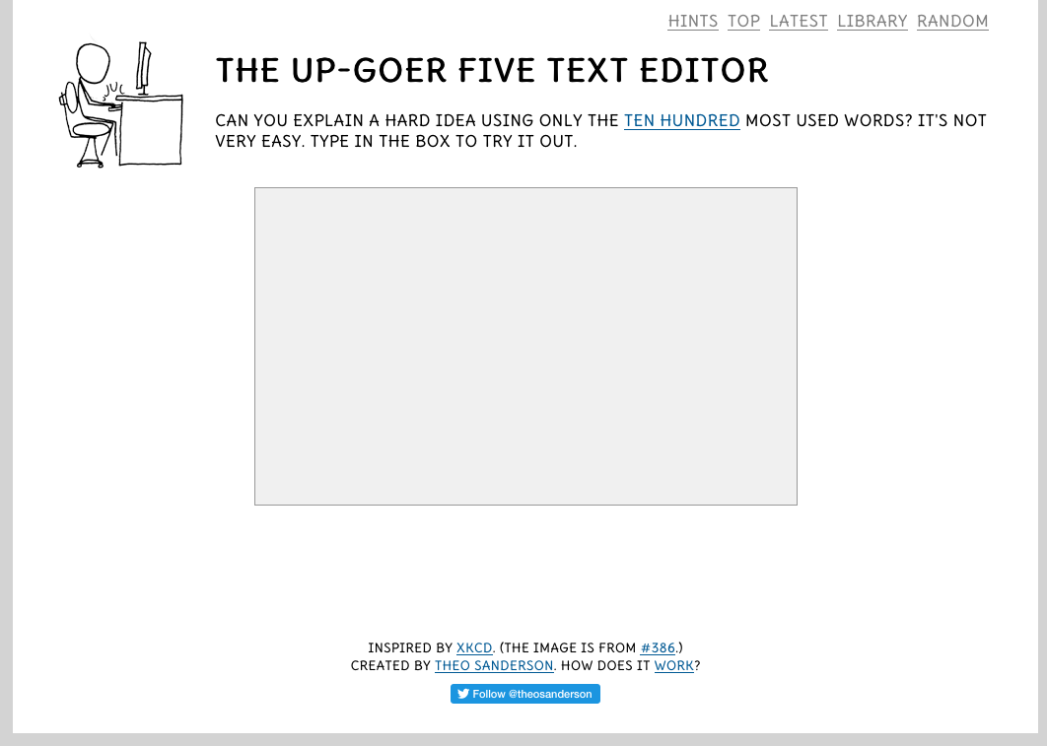
Up-Goer 5
http://splasho.com/upgoer5/

Slide 7
Creating Dyslexia Friendly Content
Readable Fonts
  Sans Serif Fonts, 12-14pt
Headings and Structure
Colour
  Use single colour backgrounds
Layout
  Left align, without justification
Writing Style
https://www.bdadyslexia.org.uk/employer/dyslexia-style-guide-2018-creating-dyslexia-friendly-content

Slide 8
Colour Blindness
8% of all men and 0.5% of all women suffer from colour blindness
99% of colour blind people suffer from red-green colour blindness
colour blind people don’t see the same colours
avoid some colour combinations that are commonly unfriendly to colour-blind users such as green/red, purple/blue, and light green/yellow.
https://uxdesign.cc/what-my-color-blindness-taught-me-about-design-d3009a93ff9c

Slide 9
Hearing Impairments
“If subtitles aren’t possible, then at least provide a description of what the video is about,” appeals Ruth. “That’s increasingly missing as people get more casual about posting content.” She recalls a video of Aretha Franklin that a friend shared on Facebook: “I see her playing the piano and I think, ‘What song is she playing? There’s absolutely no description. It’s not that I need to hear every word, but sometimes I have no idea what’s happening.”
Guidance: https://developer.paciellogroup.com/blog/2017/03/sounding-out-the-web-accessibility-for-deaf-and-hard-of-hearing-people-part-2/
Source: https://developer.paciellogroup.com/blog/2017/02/sounding-out-the-web-accessibility-for-deaf-and-hard-of-hearing-people-part-1/

Slide 10

Notes:
As you can see, a lot of the adjustments overlap – a change made for one group of users is generally useful for all users

Slide 11
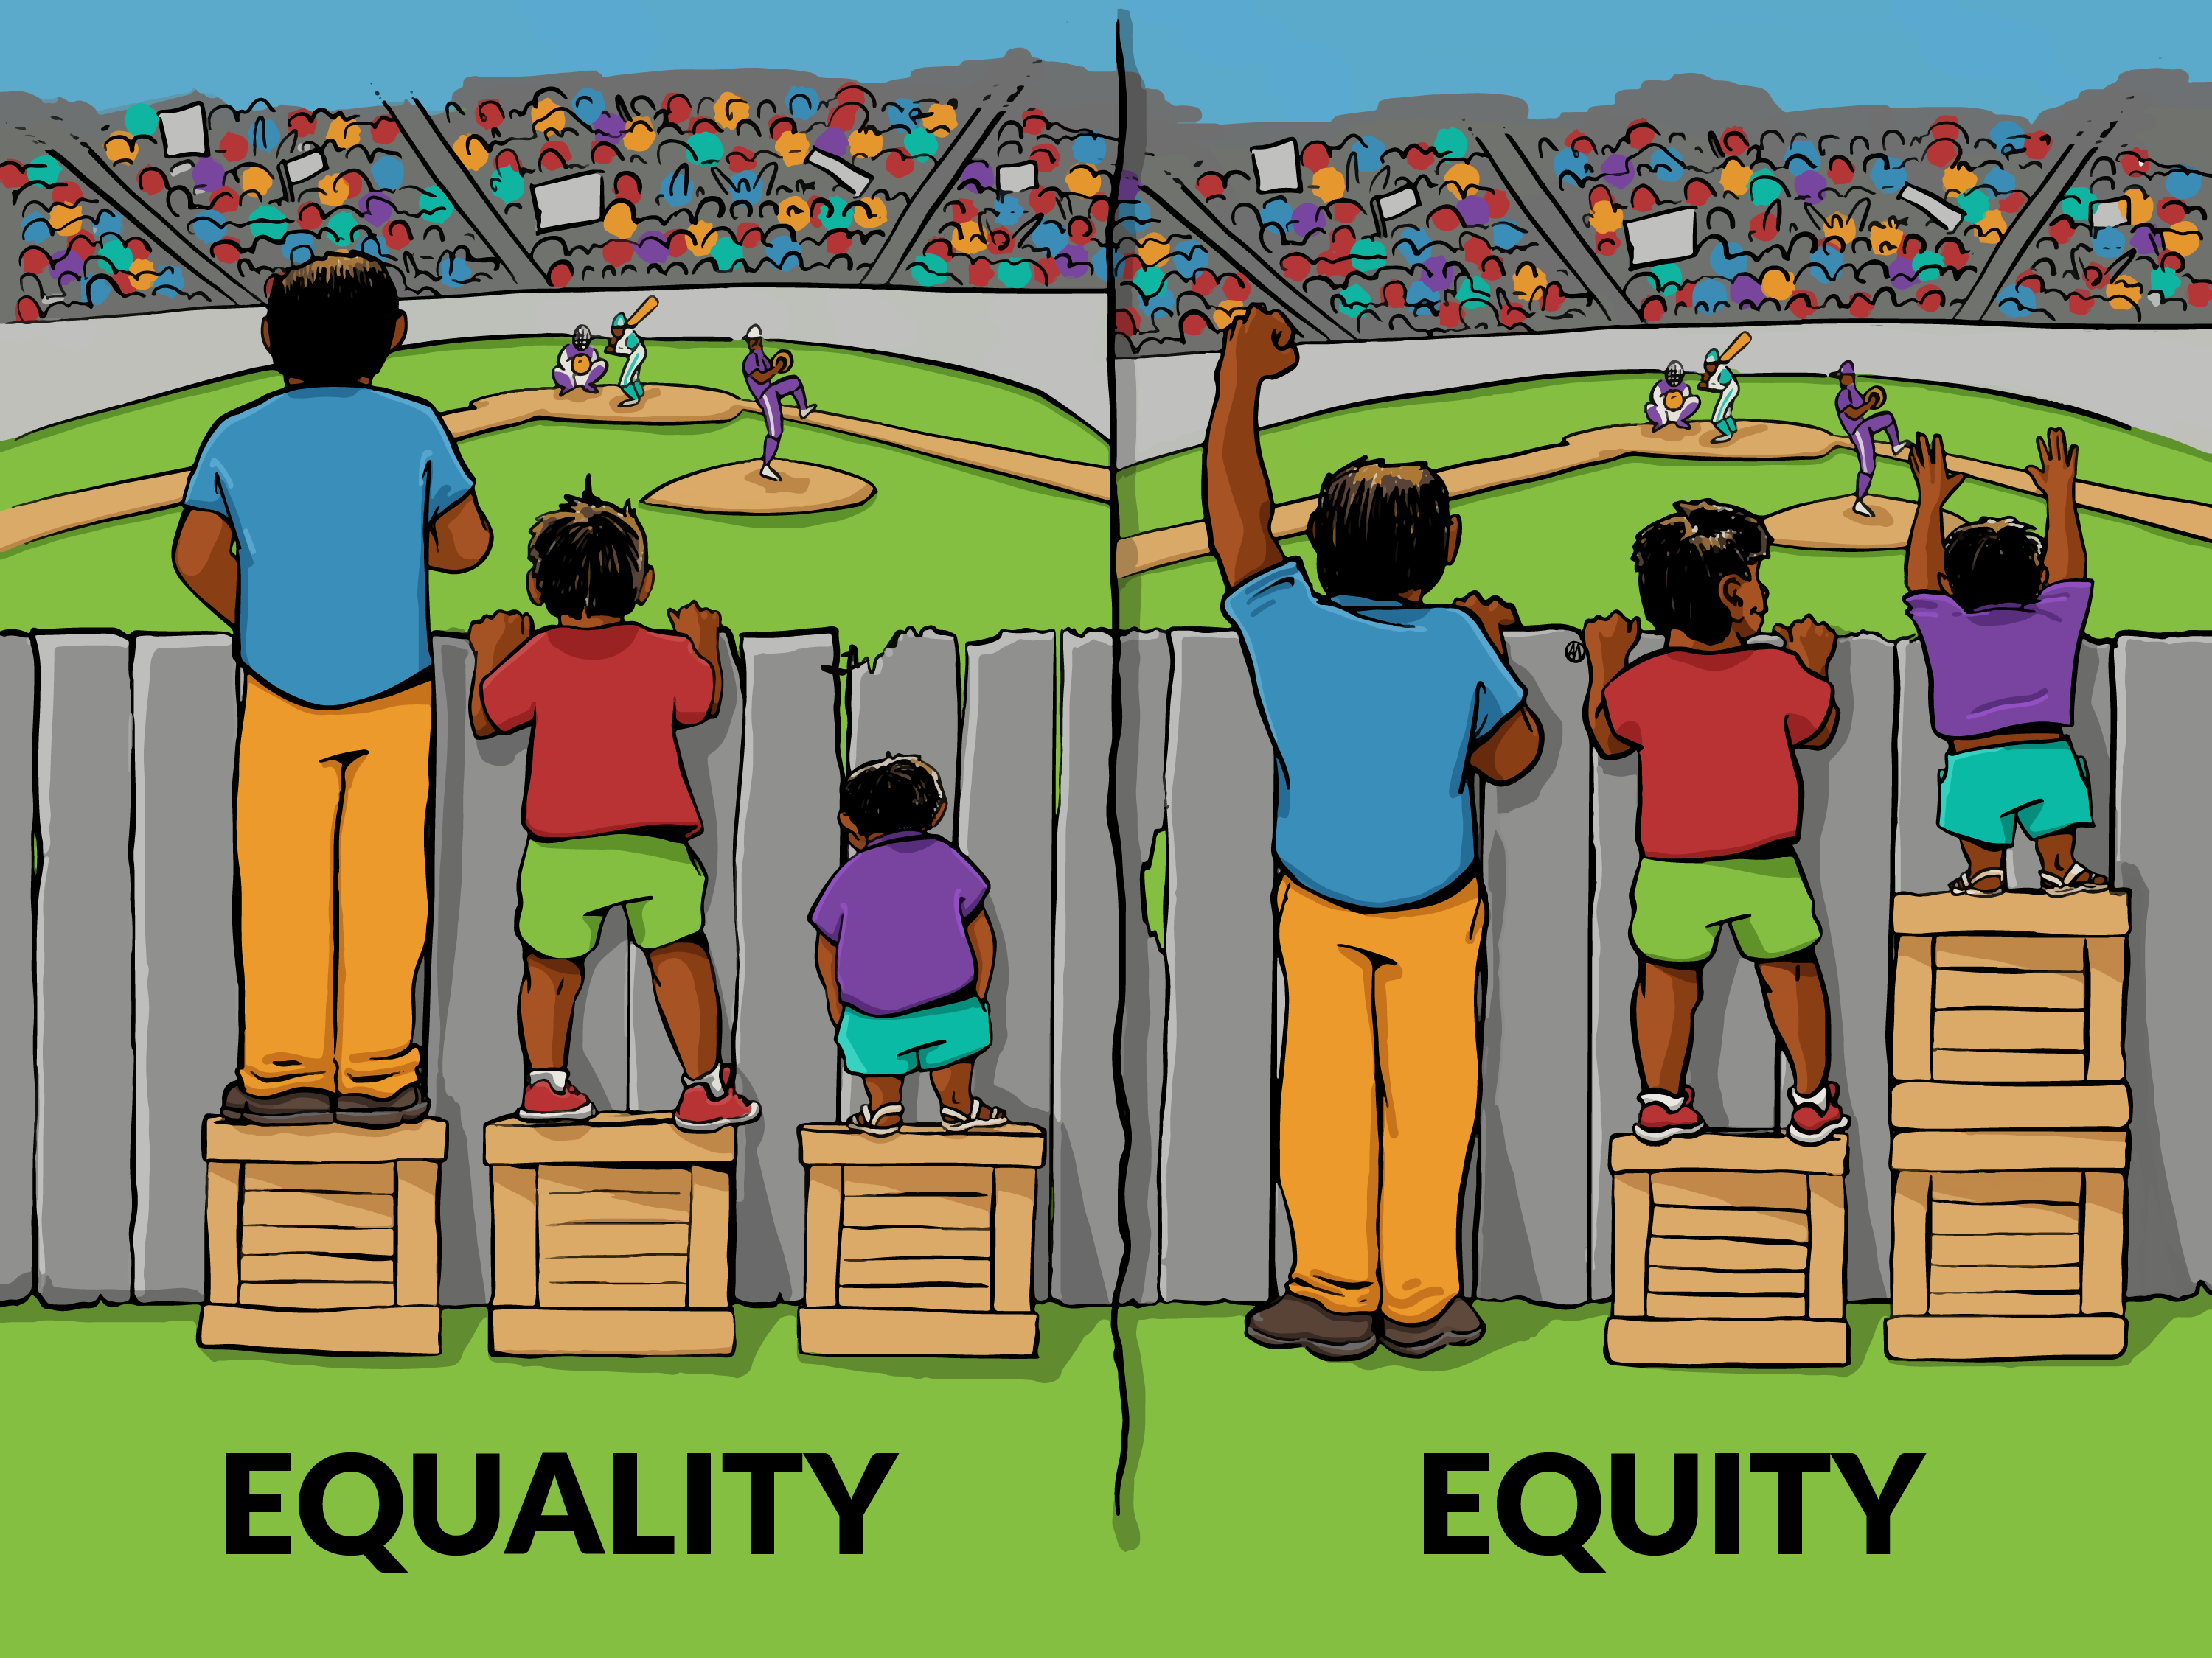
“Interaction Institute for Social Change | Artist: Angus Maguire.”
interactioninstitute.org and madewithangus.com.
The social relational model of disability identifies externally imposed disadvantage and restriction as being caused by a contemporary social organisation that takes little or no account of people who have impairments.
Notes:
Just a reminder that by making things equally available, they are not always equitably available

Slide 12

Be Open for ALL!

