Slide 1
Open Access Activity Report
May 2021
Catherine Sharp, June Hedges
UCL Library Services
catherine.sharp@ucl.ac.uk, j.hedges@ucl.ac.uk

Slide 2
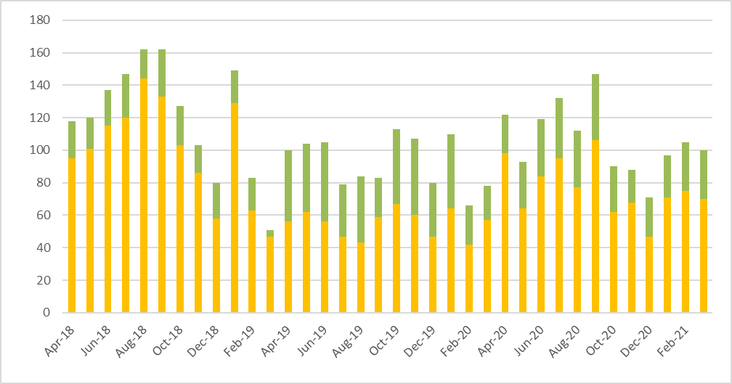
UKRI compliance
Year 7 internal target, April 20-March 21: 1,529 OA papers
Performance at end Jan: 1,036 papers (83% of target)
Announcement of new UKRI policy expected Q2 2021

Slide 3
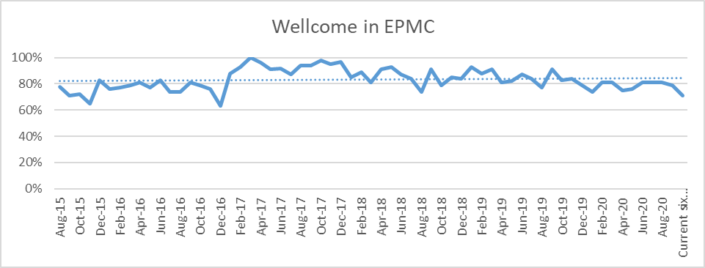
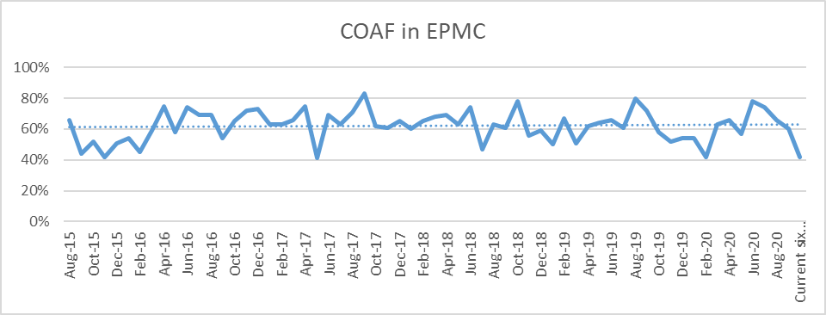
COAF compliance
Requirement is deposit in EPMC 6 months after publication
Complete figures available 6 months after publication: compliance will rise during six-month deposit window

Slide 4
All APC costs 2013-
A new format for the APC report that incorporates Transformative Agreements is in development.

Slide 5
Transformative agreements
UCL has not signed up to the CUP transformative agreement. The total additional cost of this agreement is £76K. The shortfall after UKRI/Wellcome contributions is £27K. The UCL open access budget does not have funds to support this payment for hybrid journals. This does not affect UKRI or Wellcome compliance.
The Wiley agreement will be restricted, nationally, from July, to papers funded by UKRI or COAF. This is because national demand for Wiley papers is outstripping the available credits.
Jisc is currently negotiating with Elsevier for 2022.
26 agreements
>8,200 journals

Slide 6
All BPCs

Slide 7
Budgets: UKRI
Report date 10 May 21

Slide 8
Budgets: Wellcome, CRUK, BHF
Report date 10 May 21
CRUK expenditure will rise once expenditure on transformative agreements is added.

Slide 9
Budgets: UCL open access
Report date 10 May 21
UCL’s open access budget funds papers in fully open access journals only.
This year’s budget is fully expended, but reimbursements from other budgets should allow UCL to continue to fund publication in fully open access journals until the end of June 2021.
As more transformative agreements are offered, and more authors choose to publish open access, UCL’s open access budget may not be insufficient to satisfy all UCL author OA requests next year.
It has not been possible to afford the Cambridge University Press transformative agreement for 2021. This would have required an additional £27K UCL funding.
As costs under transformative agreements are reallocated to “publishing”, research-intensive universities will pay more for transformative (read and publish) agreements.

Slide 10
Open access in REF submission
63,000 papers have been made open access in UCL Discovery since the REF open access policy began (April 2016)
The current REF open access policy continues to apply until after the forthcoming policy review
Compliance reporting will resume shortly
The compliance reports will be adjusted later this year to cover only papers published in the new REF period

Slide 11
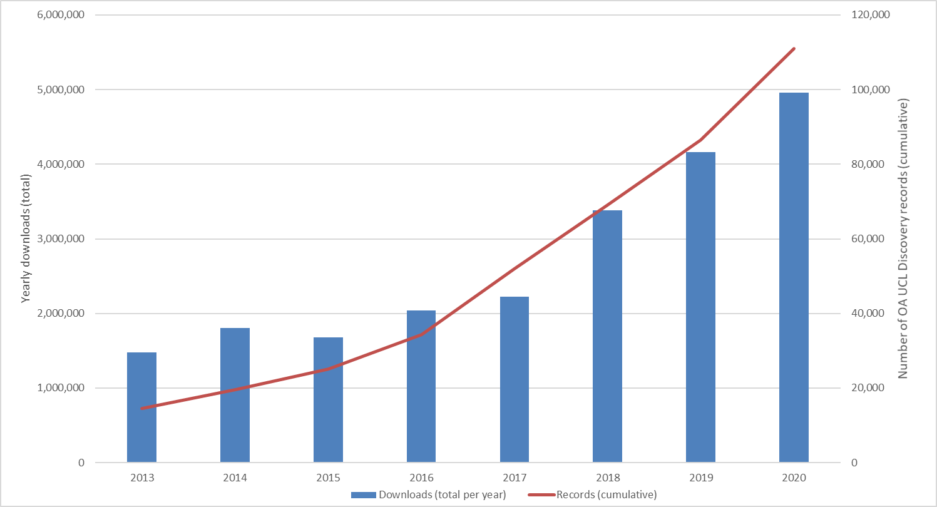
Discovery: Downloads+OA records

Slide 12
Most-downloaded outputs: 1/4-11/5

Slide 13
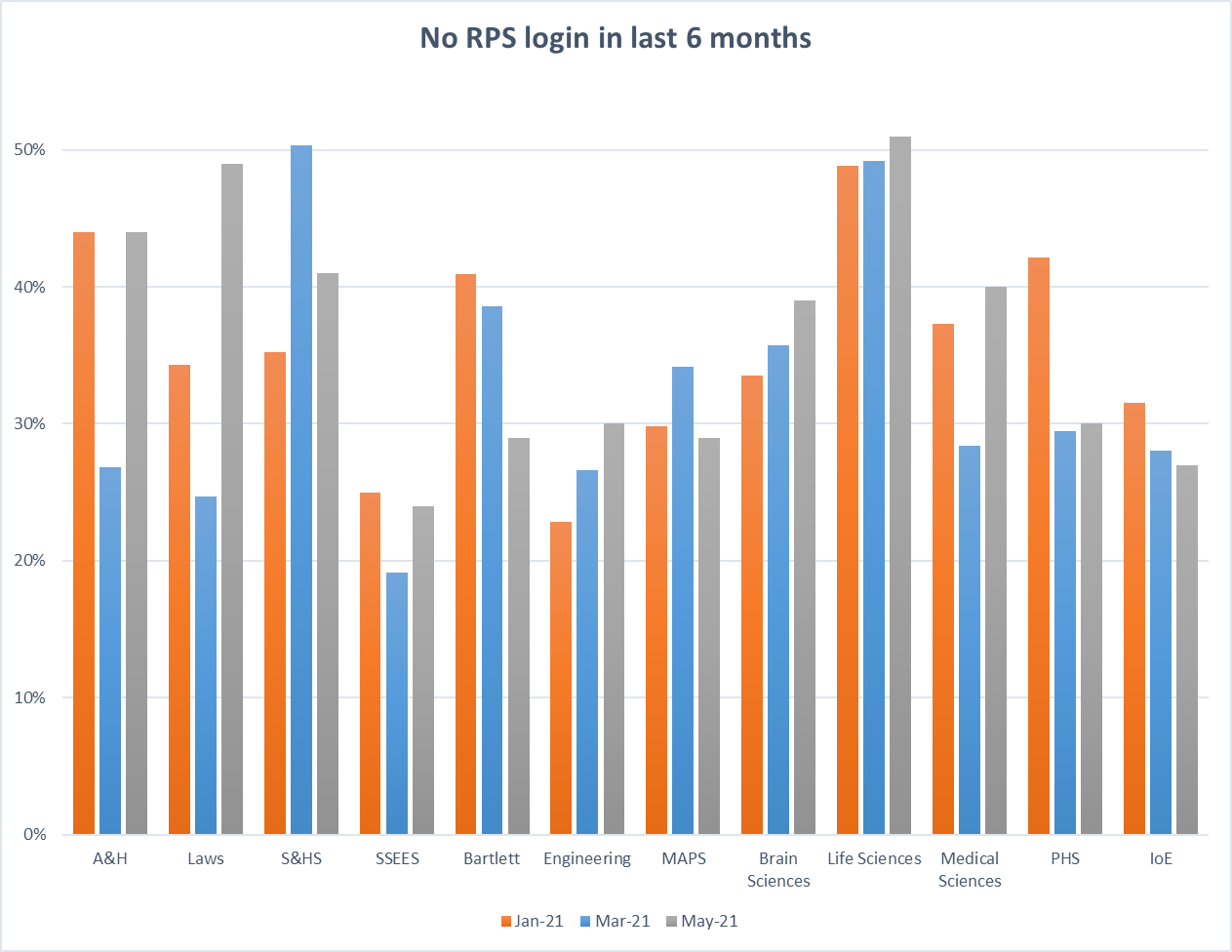
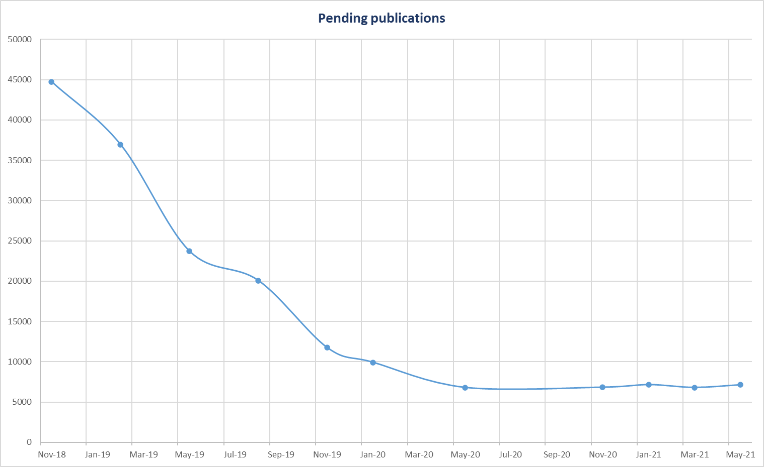
RPS engagement report

