Slide 1

Textbooks and Open Access publishing via UCL Press
Dr Paul Ayris
Pro-Vice-Provost (UCL Library Services)
E-mail: p.ayris@ucl.ac.uk
Twitter: @ucylpay

Slide 2

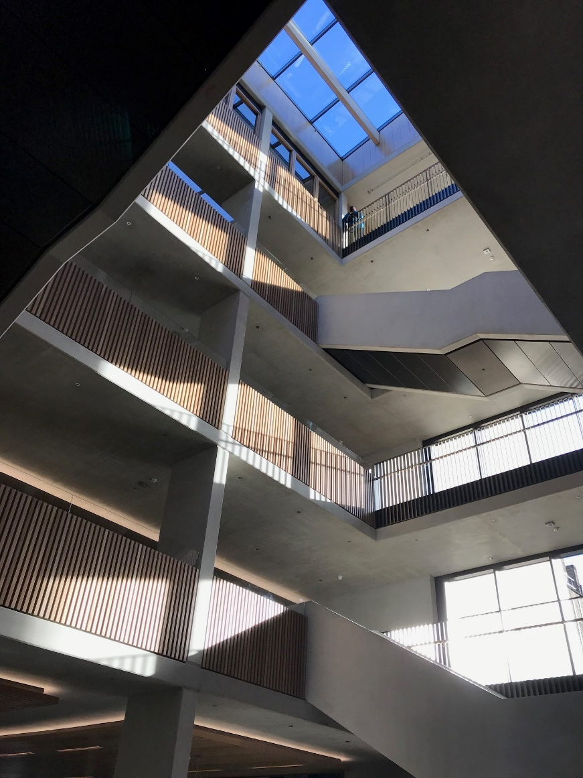
UCL Main Quad
UCL Student Centre,
opened 18 February 2019

Slide 3
European Commission: Open Science Policy Platform – 8 pillars of Open Science
Future of Scholarly Communication
EOSC (European Open Science Cloud)
FAIR Data
Skills
Research Integrity
Rewards
Altmetrics
Citizen Science

Slide 4
European Commission: Open Science Policy Platform – 8 pillars of Open Science
Future of Scholarly Communication
EOSC (European Open Science Cloud)
FAIR Data
Education and Skills
Research Integrity
Rewards
Altmetrics
Citizen Science

Slide 5
Benefits of an OA University Press
Taking publishing back into the university system – the university supports the entire research life cycle
Challenge the prevailing scholarly publishing model – issue of low dissemination
Support for OA to AHSS outputs, which receive less funding than STEM
Social impact: research available to the public and policy makers
Global impact: outputs reach regions in which research is unavailable or unaffordable
Motivation for academics: they want their research to be widely read
Added reputational value of a university press, through global dissemination, publicity, reviews
Consistent with Open Science agenda
Opportunities for integration of research and learning

Slide 6
Benefits of an OA University Press
Taking publishing back into the university system – the university supports the entire research life cycle
Challenge the prevailing scholarly publishing model – issue of low dissemination
Support for OA to AHSS outputs, which receive less funding than STEM
Social impact: research available to the public and policy makers
Global impact: outputs reach regions in which research is unavailable or unaffordable
Motivation for academics: they want their research to be widely read
Added reputational value of a university press, through global dissemination, publicity, reviews
Consistent with Open Science agenda
Opportunities for integration of research and learning

Slide 7
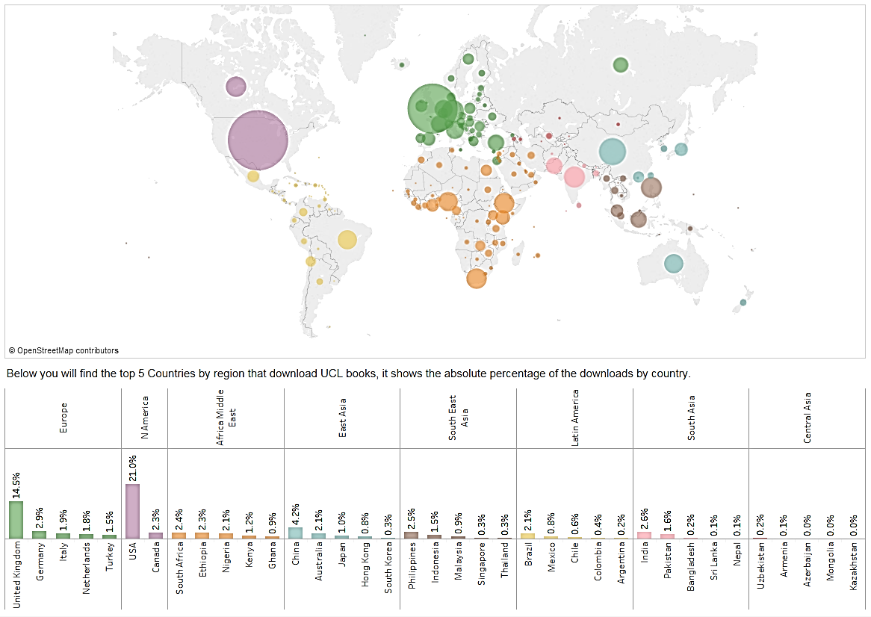
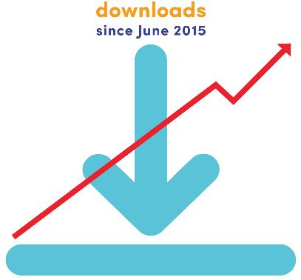
229 countries
1.8 million
UCL Press downloads
since June 2015
Notes:
Total book and journal downloads since launch in June 2015
Some books published for two years, some for just one month
Percentage: JSTOR c.50%, UCL Discovery c.35%, rest: OAPEN, Worldreader

Slide 8
Textbooks
One of the first Open Access textbooks published by UCL Press
54,769 downloads (Feb18)
175 print sales

Slide 9
Impact
How the World Changed Social Media authored by UCL Professor of Anthropology Daniel Miller and a collective of eight other esteemed global anthropologists is the most read UCL Press output
298,799 downloads (Feb18)
544 print sales

Slide 10
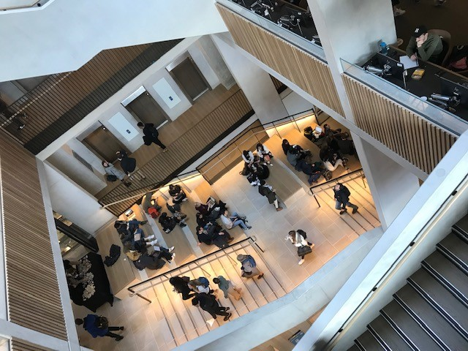
Conclusion
Open Science is good for the researcher / educator / reader
It is also good for research
Open Science is an opportunity, not a threat
UCL Student Centre
Over to you…

