Slide 1
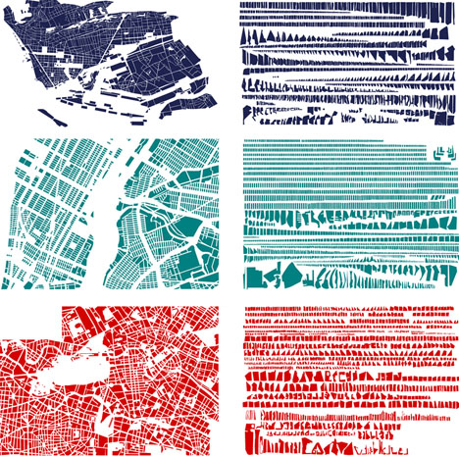
Developing global citizens:
Open Data as Open Educational Resources
Dr Javiera Atenas
Latin American Initiative for Open Data
Open Education Working Group

Slide 2
All citizens should have equal opportunities and multiple channels to access information, be consulted and participate. Every reasonable effort should be made to engage with as wide a variety of people as possible
(OECD, 2009, p.17).

Slide 3
Open data is data that can be freely used, re-used and redistributed by anyone - subject only, at most, to the requirement to attribute and sharealike. http://opendatahandbook.org/guide/en/what-is-open-data/

Slide 4
Open Data Open Definition
Availability and Access: the data must be available as a whole and at no more than a reasonable reproduction cost
Re-use and Redistribution: the data must be provided under terms that permit re-use and redistribution including the intermixing with other datasets.
Universal Participation: everyone must be able to use, re-use and redistribute - there should be no discrimination against fields of endeavour or against persons or groups.

Slide 5
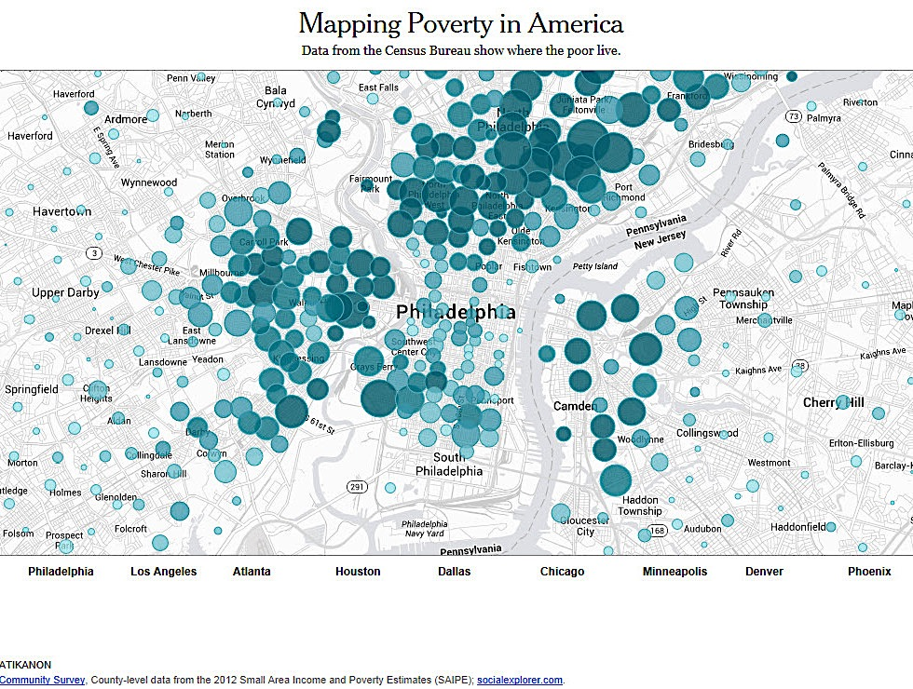
Open Data

Slide 6
The Value of Open Data
Open data is an invaluable resource for scientific communities
Supports and encourages more transparent research practices
Supports scientific development and reproducibility
Can be used to model good practices in academia for research and teaching

Slide 7
Where does OD come from?
International agencies and organisations
  Word Bank ; United Nations ; EU
National Governments and their agencies
  UKOD; GermanyOD; USA
Local governments
  Sardinia ; London; Barcelona
Non-governmental organisations
  ODI; Monithon
Academic institutions and research centres

Slide 8
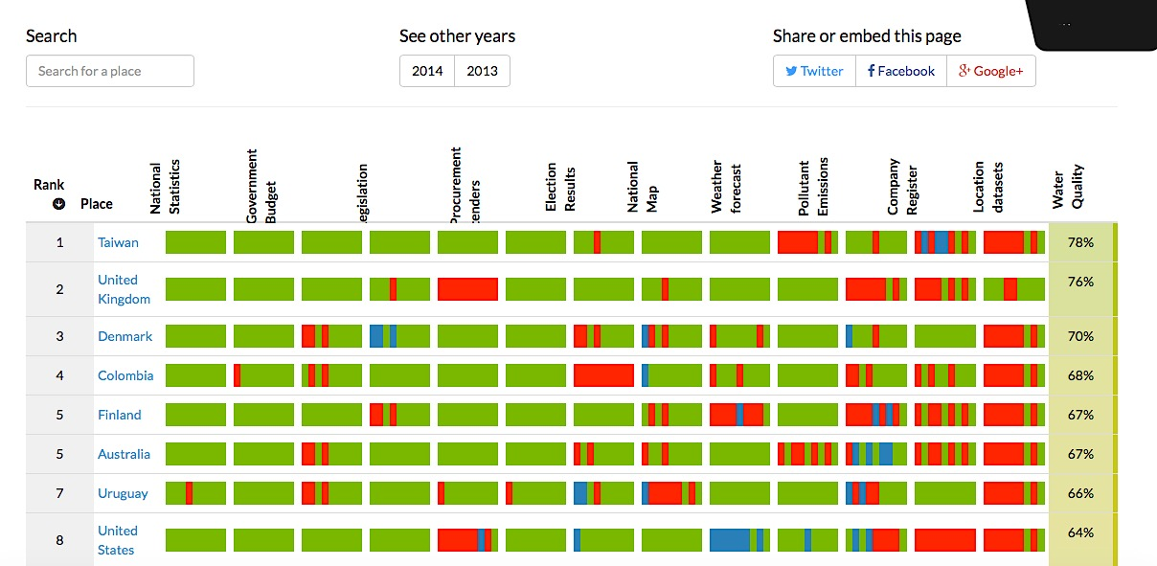
Where does OD come from?

Slide 9
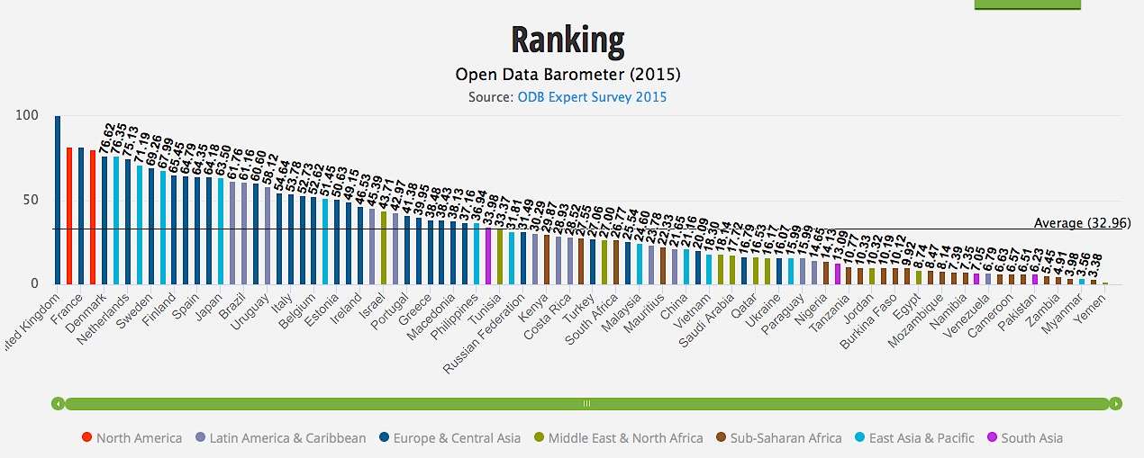
Where does OD come from?

Slide 10
How can OD be used in HE?
Collaborating with researchers in real research projects
Collaborating with students from other disciplines
Creating scenario-based learning activities
Collaborating with their local communities working on real problems

Slide 11
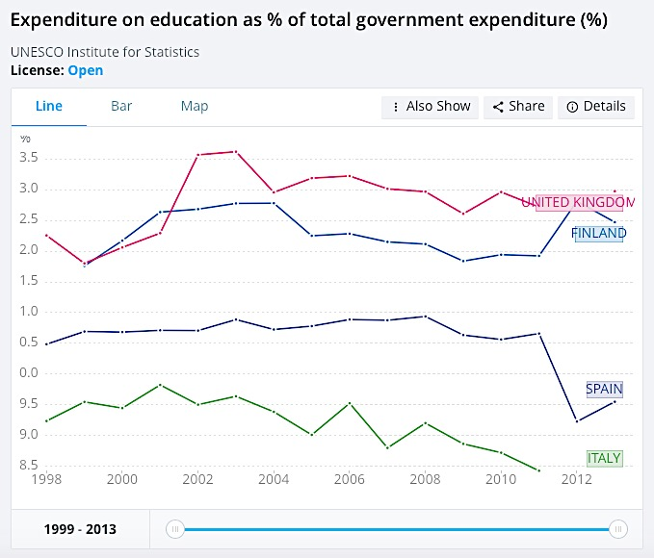
How can OD be used in HE?

Slide 12
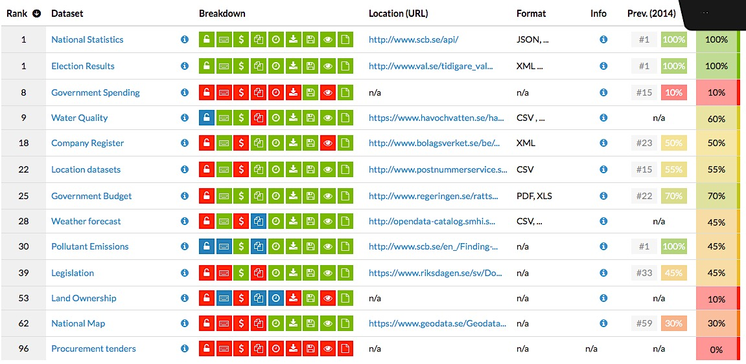
How can OD be used in HE?

Slide 13
Open Data for Skills Development
Development of critical skills
Development of analytical skills
Development of research skills
Development of data literacy skills
Development of teamwork skills
Development of citizenship skills

Slide 14
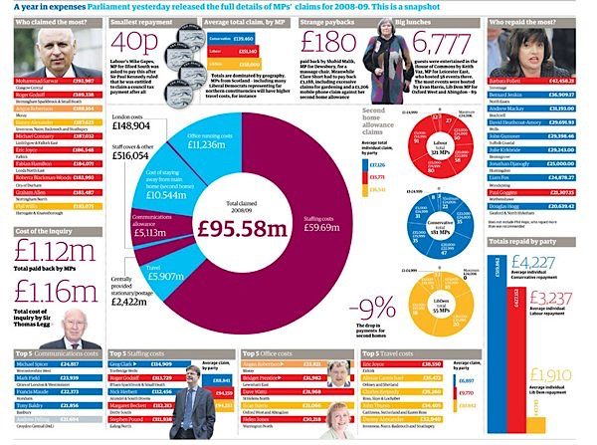
The value of Data

Slide 15
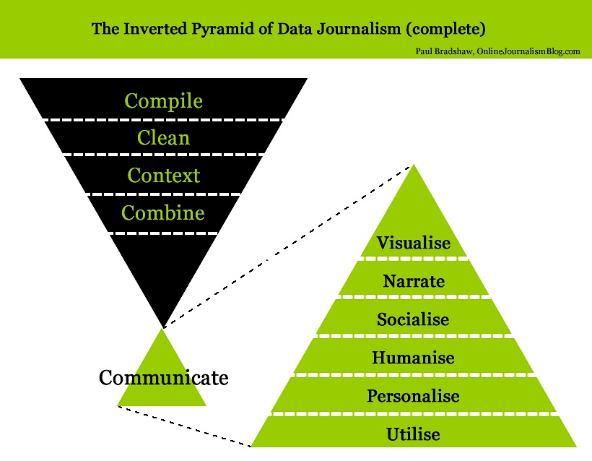
Data Literacies

Slide 16
Data Literacies

Slide 17
Data Literacies

Slide 18
Open Data and citizenship

Slide 19
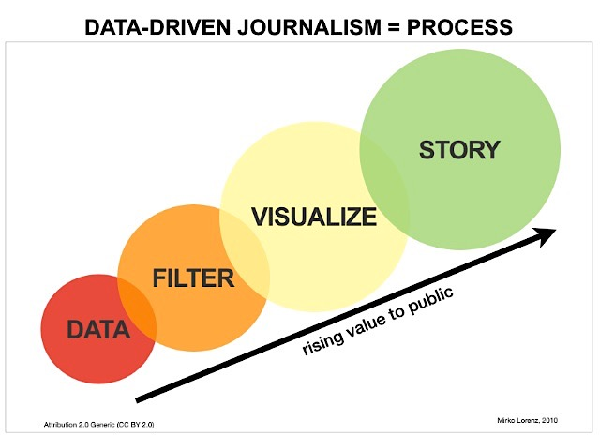
Data Storytelling

Slide 20
Open Data in T&L activities
Identify and describe the learning outcomes for the intended activities;
Identify the portals which will source the data;
Clearly identify and describe the challenges students might face;
Provide training materials for the software students will need to analyse the data;
Support students in communicating their findings to local or wider communities.

Slide 21

To learn more about OD and
Open Education
Open Definition http://opendefinition.org
Open Data Handbook http://opendatahandbook.org
Open Education Handbook http://education.okfn.org/handbook/
Open Data as Open Educational Resources https://education.okfn.org/files/2015/11/Book-Open-Data-as-Open-Educational-Resources1.pdf
Open Data as Open Educational Resources: Towards Transversal Skills and Global Citizenship http://www.openpraxis.org/index.php/OpenPraxis/article/view/233
Figshare http://figshare.com
Open Data as OER http://education.okfn.org/the-21st-centurys-raw-material-using-open-data-as-open-educational-resources/

