Slide 1
open, networked, connected open educational practices for a connected curriculum
Leo Havemann and Jo Stroud
UCL Digital Education
Opening UCL | 13 March 2019

Slide 2
the connected curriculum
Research-based approach
Interdisciplinarity
Permeability of learning communities
Assessment that addresses audiences beyond markers
Notes:
Fung, D. (2017). A Connected Curriculum for Higher Education. UCL Press. London. Retrieved from: https://www.ucl.ac.uk/ucl-press/browse-books/a-connected-curriculum-for-higher-education

Slide 3
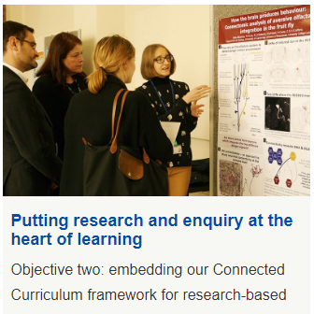
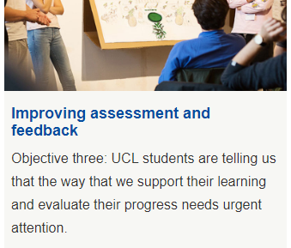
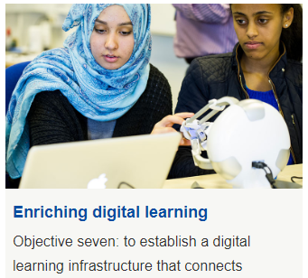
education strategy 2016-21
connect students with each other, with staff, with research and with the outside world to support networked, research-based and interdisciplinary education

Slide 4
exploring connections between CC and OE
the connected curriculum presents a WHY, a pedagogical rationale
open education suggests a HOW (or rather, a range of relevant approaches)

Slide 5
troubling ‘openness’
‘Open education’ often carries the weight of describing not just policy, practices, resources, curricula and pedagogy, but also the values inherent within these, as well as relationships between teachers and learners. So is open education a slogan or a philosophy, a metaphor, model, or movement?
(Cronin & MacLaren, 2018, p. 127)
Notes:
Cronin, C., & MacLaren, I. (2018). Conceptualising OEP: A review of theoretical and empirical literature in Open Educational Practices. Open Praxis, 10(2), 127–143. https://doi.org/10.5944/OPENPRAXIS.10.2.825

Slide 6
open… but in what sense?
like an open resource – free to access, openly licensed
like an open course – free* to enrol and study (*conditions apply)
like an open university
as a practice – a way of being or an orientation towards work/learning/teaching
Notes:
the university acknowledges and celebrates the ambiguity of openness in its mission statement: “The Open University’s mission is to be open to people, places, methods and ideas” (Open University, n.d. http://www.open.ac.uk/about/main/strategy-and-policies/history-ou).

Slide 7

open education as a wide umbrella
Closely identified with current digital practices: OER, MOOCs - but a history of ‘openness’ precedes these
Therefore, situated, contextual
What is open(ed) changes according to context, purpose, participants

Slide 8
key drivers
Enhancing educational practice, ‘sharing the burden of innovation’, connecting participants to widen conversation
Social justice and inclusion, supporting international development, through increased access, cost savings
Knowledge as a public good rather than commodity* (*conditions apply)

Slide 9
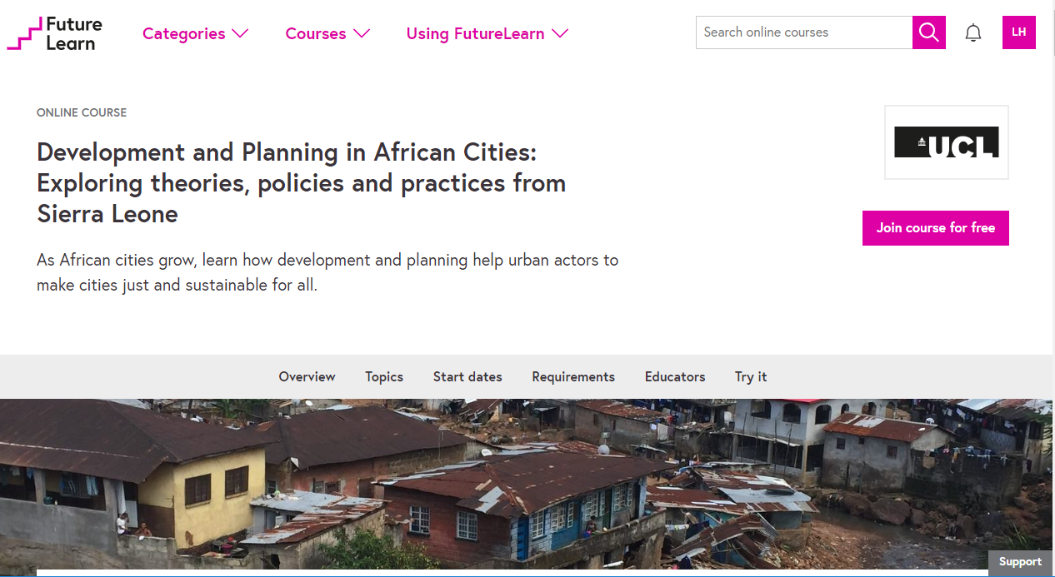
Notes:
While such material has previously been offered in London, a face-to-face, intensive iteration of the course delivered with Njala University in Sierra Leone has been very successful and is heavily oversubscribed. Despite this demand, for many there exist issues which prevent travel to study, and it was considered, therefore, that delivering some of the topics as an open online course could enable the team to meet demand. However, the approach also presented a unique opportunity to bring together, open access to, and enable the subsequent reuse of rich and topic-specific testimony from UCL, international, and in-country experts.
…they engaged with open educational practices in a variety of ways, employing the practical principles of Universal Design to deliver content that was accessible to varied audiences, and open pedagogic methods. For example, while the course utilised Freetown as an overarching case study, learners were invited to discuss, apply, align the concepts and techniques covered to their own contexts, wherever they were in the world.
A further decision was taken to make course content accessible outside of its original context as OER, and made available via UCL’s OpenEd@UCL respository pilot scheme - these materials are currently its most viewed and downloaded. They also represent the first full set of course materials to be made available on the platform. Future work will look to explore how it might be possible to promote localisation activities through provision of supporting documentation.

Slide 10
students working in the open
CC and OE propose that students create assignments for real audiences, rather than traditional, ‘disposable’ assignments
UCL anthropology students examining socialist societies have been producing a ‘web essay’, previously using MyPortfolio (Mahara) and currently on UCL Reflect (Worpress)
With permission I am sharing Ania Milligan’s web essay You are what you eat: How food can explain why socialism failed in Poland

