Slide 1
Open education
OPEN EDUCATION
oer@ucl.ac.uk | www.ucl.ac.uk/oer | @OpenUCL on Twitter
Introducing OpenEd@UCL
13 March 2019

Slide 2
OPEN EDUCATION
oer@ucl.ac.uk | www.ucl.ac.uk/oer | @Openn Twitter
OPEN EDUCATION
oer@ucl.ac.uk | www.ucl.ac.uk/oer | @OpenUCL on Twitter
Open Education at UCL
Institutional drivers
OpenEd@UCL
Future developments

Slide 3
Open Education at UCL
Open education has been at UCL for years…
UCL Education Strategy 2016–21 (Objective 7) states that by 2021…
“we will have introduced an open education resources (OER) service to provide a showcase for UCL education and for student-generated content, and to bring together internal resources of common interest in support of the connected curriculum”

Slide 4
Open Education at UCL
Open Education Roadmap (2017)
Five components:
Pilot Open Education repository
Case studies
Open Education strategy for UCL
Community of practice
Portfolio of policies and guidance

Slide 5
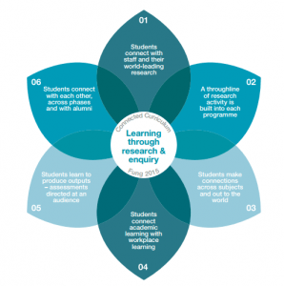
Open Education at UCL
Connected Curriculum
UCL’s research-based teaching framework, which aims to ensure that all UCL students are able to learn through participating in research and enquiry at all levels of their programme of study.
03: Students make connections across subjects and out to the world
05: Students lead to produce outputs – assignments directed at an audience
06: Students connect with each other, across phases and with alumni
https://blogs.ucl.ac.uk/ccfellows/sample-page/

Slide 6
Benefits of Open Education for UCL
Open Education at UCL
Wide dissemination of UCL teaching and learning resources (staff and student generated)
Increase UCL’s international profile as a global education leader (research-based education), and as a leader in Open Scholarship
Increase the range of high-quality resources available to UCL’s non-traditional learners, without the need to pay additional subscription/license fees
Internal/external marketplace providing access to course ‘tasters’ and cross-disciplinary resources
Long-term curation of UCL’s teaching assets

Slide 7
Open Education at UCL
What is UCL doing?
Infrastructure (inc. repository)
Policy
Practice
These activities build on UCL’s commitment to “open education to all”

Slide 8
Open Education at UCL
Open Education Repository Project Phase 2 (18/19)
Deliver a proof of concept repository for UCL-created educational resources
To include staff and student generated materials
Promotion of Open Education and of the repository at UCL
Collect Initial User Feedback
Devise metrics to measure use of UCL’s open education materials

Slide 9
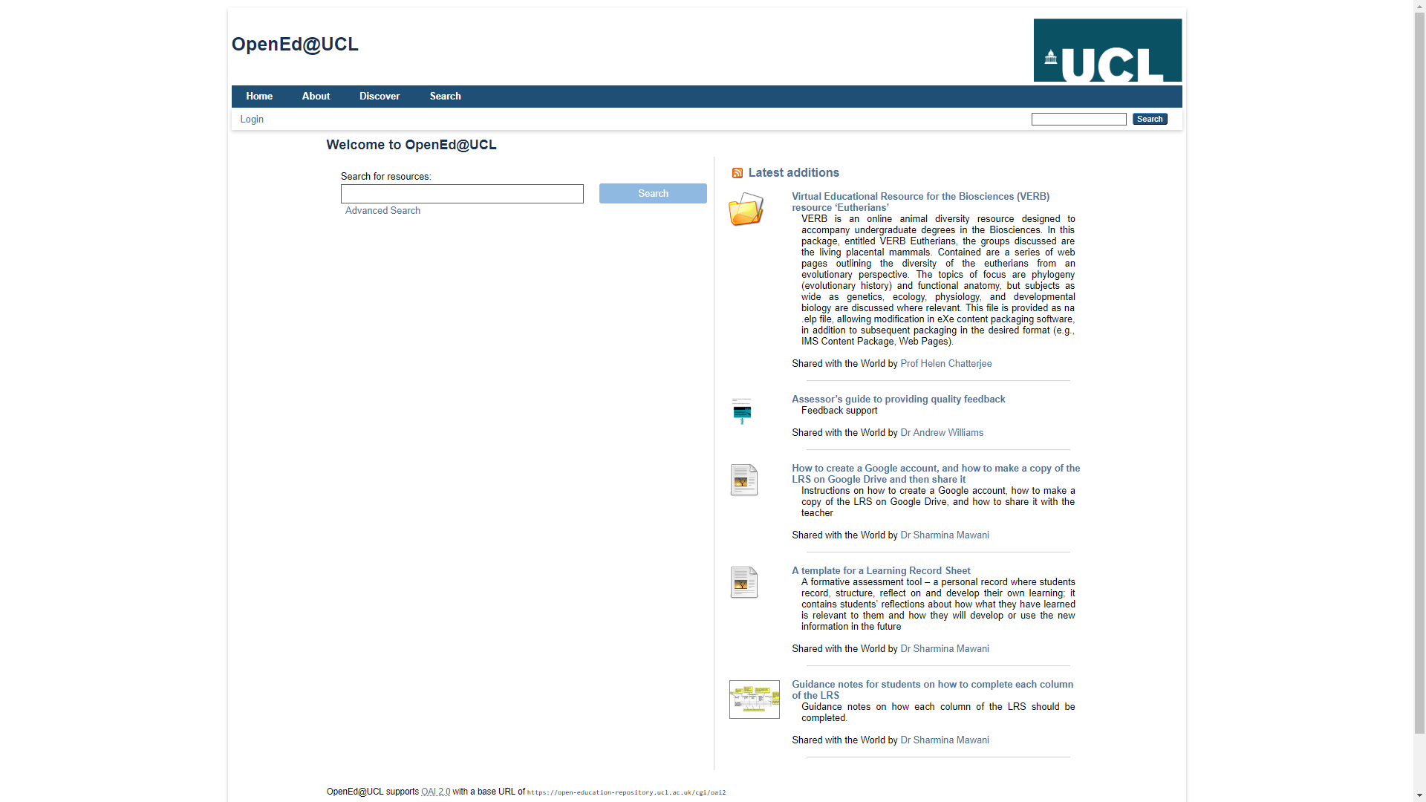
Open Education at UCL
https://open-education-repository.ucl.ac.uk/

Slide 10
OpenEd@UCL: activity overview
Open Education at UCL

Slide 11
OpenEd@UCL: activity
Open Education@UCL

Slide 12
Open Education at UCL
Open Education at UCL
Focus of next phase of development
Broader scope to include additional use case – a ‘Trove’ for the strategic management of UCL’s education outputs (open or not).
Procurement exercise (based on requirements and business case developed during current phase) with view to delivering a full service
Further promotion of Open Education practice at UCL

Slide 13
Open Education at UCL
Questions?
More information: http://www.ucl.ac.uk/oer

