Slide 1
Understanding and using feedback effectively
Dr Andrew Williams

Slide 2
How is feedback provided at University?
What differences are there between school/college and university teaching + assessment?
Large class sizes
Modularity of programmes
Anonymous marking
Not as personalised as school/college
More formal

Slide 3
What is feedback for?
Student development
To enhance academic performance (academic literacy)
Provide advice to improve skills/knowledge
Learn how to be objective (don’t take feedback personally)
Become a reflective learner
Promote dialogue
Motivation
Feedback is a unique form of communication!

Slide 4
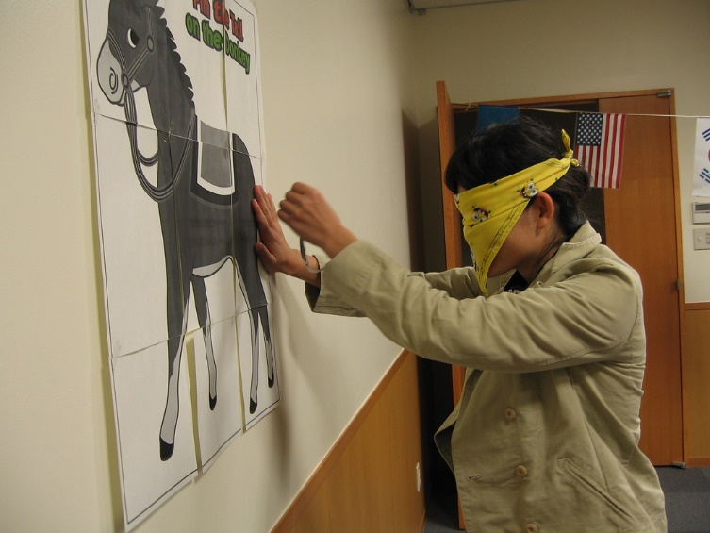
Why is feedback important?
Learning without feedback is like ‘pin the tail on the donkey’
Feedback is indispensable to effective learning
Optimises the conditions in which you can achieve your best

Slide 5
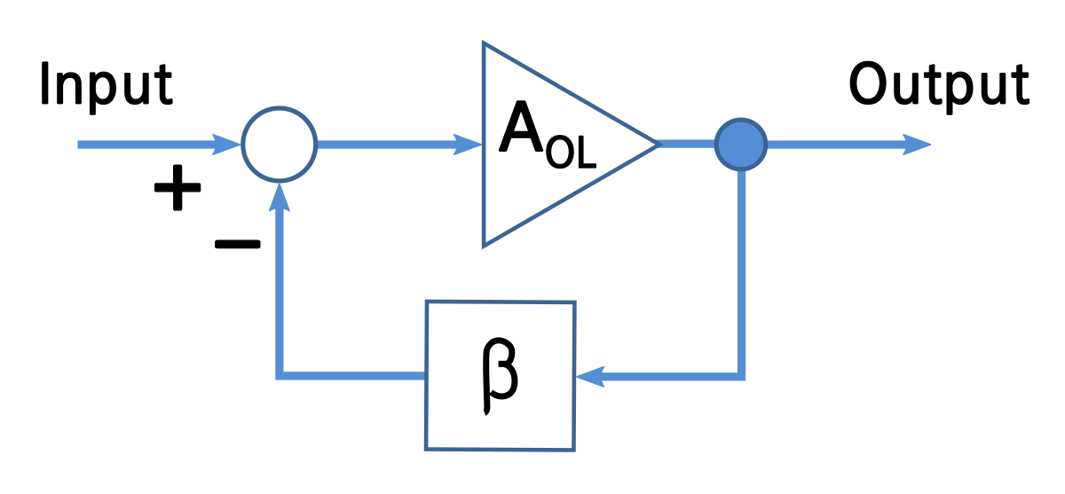
How would you define feedback?
The returning part of the output of a circuit
Sound fed into a system within a loop
Reinforcement of the right answer
Verbal and nonverbal responses from others that are capable of being perceived
and used by the individual initiating the behaviour
Responses fro tutors or peers that provide information
to students about how well they are on course to reach their target

Slide 6
How would you define feedback?
Responses from tutors or peers that provide information
to students about how well they are on course to reach their target
Analogy – similar to the way a rocket receives feedback in order to land (reach its target).

Slide 7
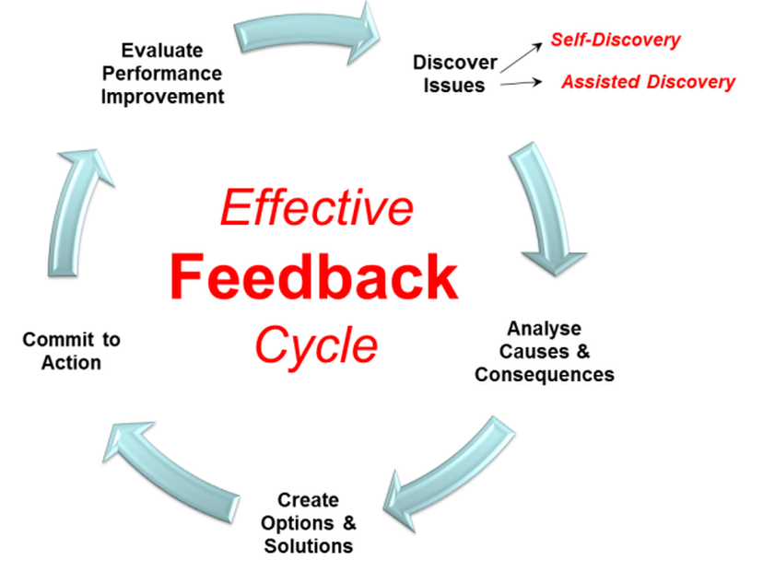
Effective use of feedback
Feedback
Feedforward
Assisted discovery
Self-discovery

Slide 8
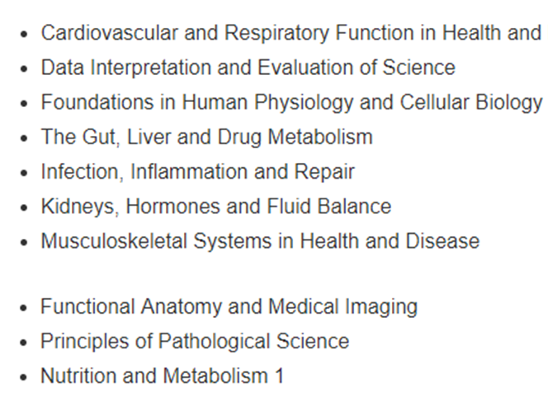
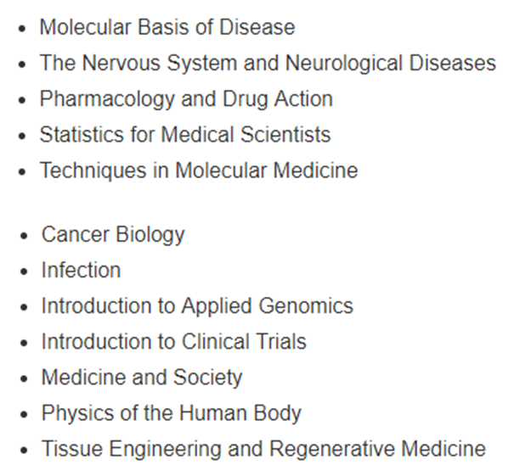
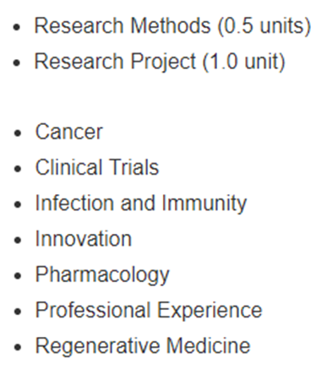
Effective use of feedback – coping with modularity
Year 1 Year 2 Year 3
Action on feedback
Individual development - feedback to help feedforward

Slide 9
Types of feedback
‘You make clear and concise points when describing the action of innate immune cells but fail to describe the mechanisms in full. You could be more critical when discussing these mechanisms in relation to the literature.’
Good points versus areas for improvement
Unpacking feedback

Slide 10
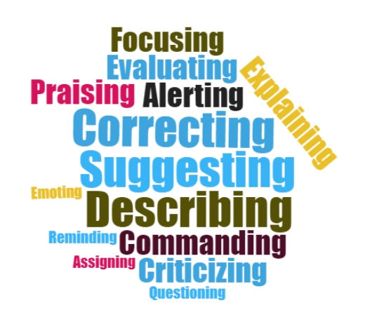
Types of feedback
Formative
Help identify areas that need improvement.
Monitor student learning.
Help improve teaching.
Low stakes - no formal grade.
Summative.
Evaluate student learning.
Normally at end of teaching unit.
High stakes - formal grade.
Can also be used formatively.
Improve on future assignments.
What do you want?

Slide 11
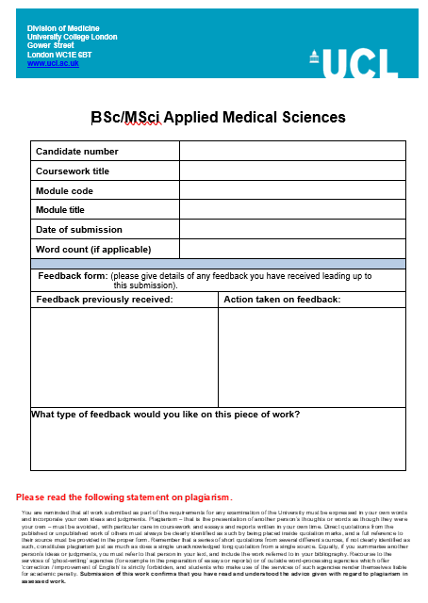
Taking action on feedback
What do you do with feedback?
Feedback is pointless unless you take action on it!
Using feedback to feedforward.
Do you understand your feedback?
How will you use your feedback to improve in the future?
Encourage critical thinking.

Slide 12
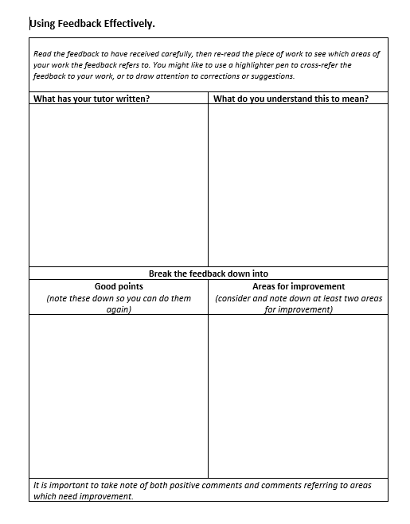
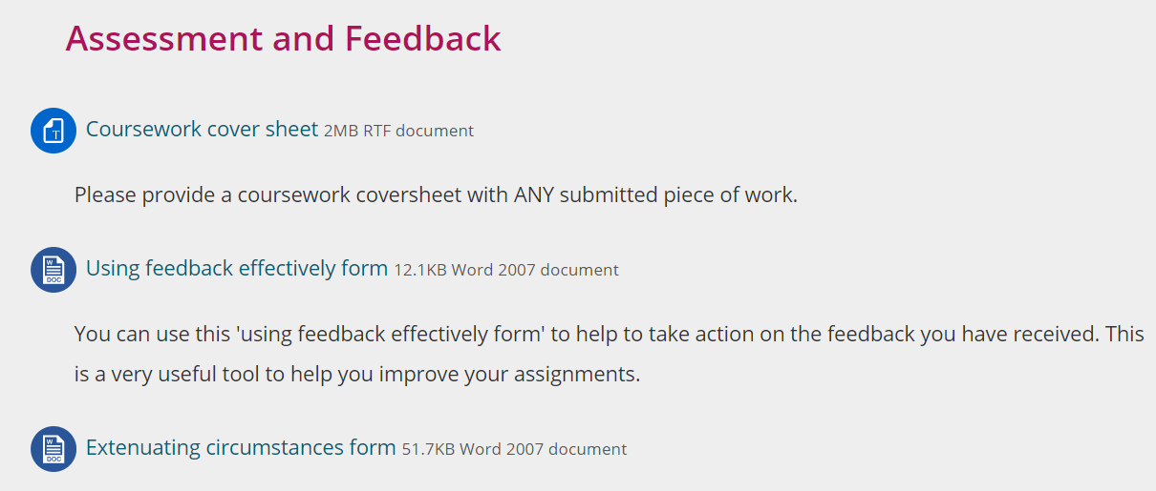

Slide 13
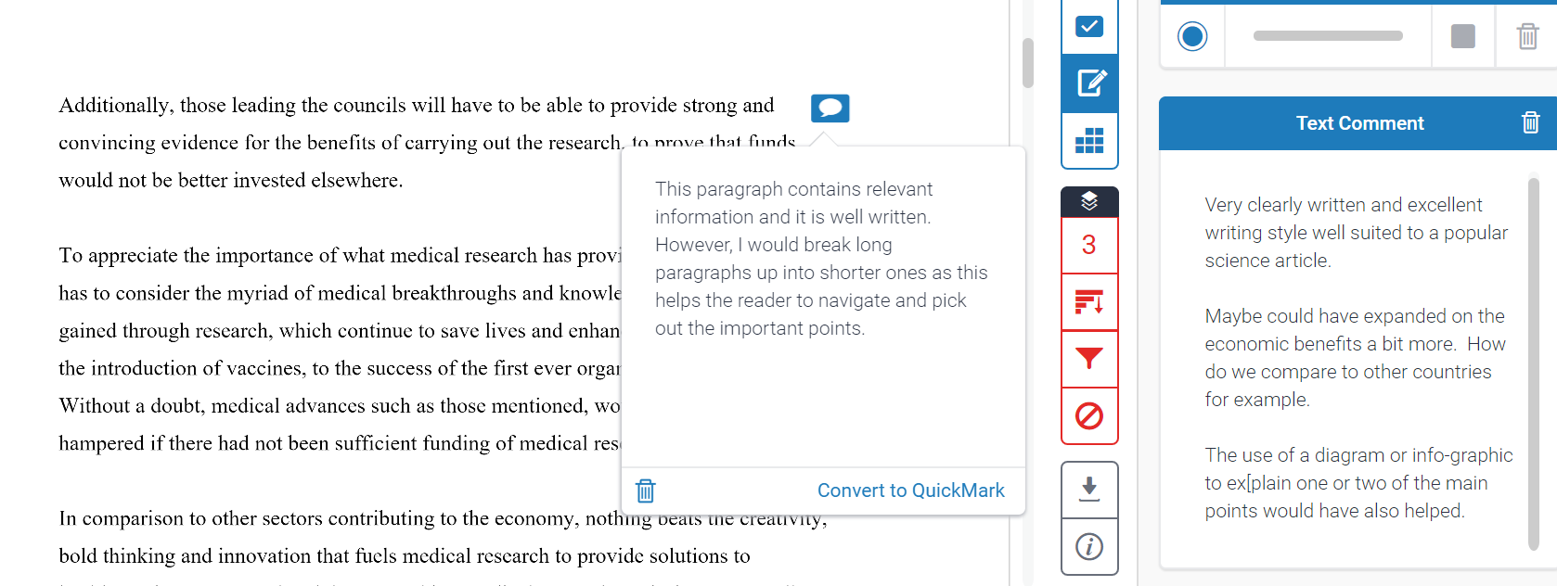
Using feedback on Turnitin

Slide 14
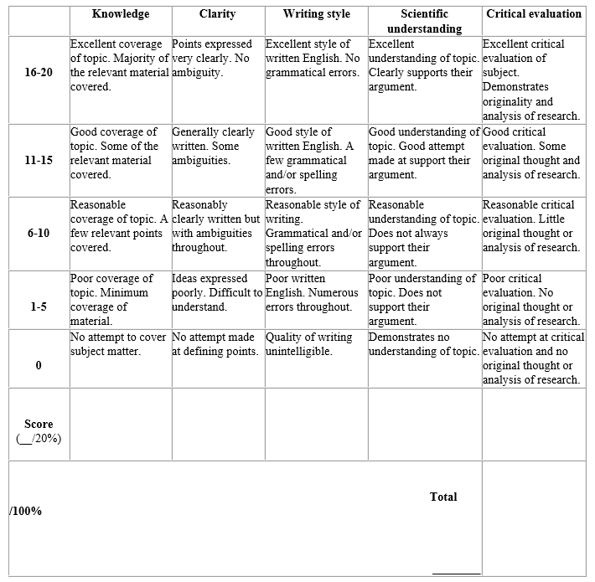
Relating feedback to marking rubrics
Assessment specific
Criteria-driven
Criteria can be abstract
Tests attainment level
Use for personal development
Provides final grade

Slide 15
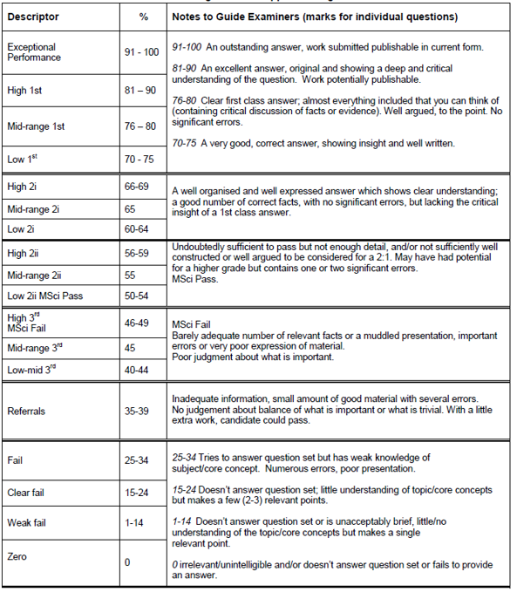
Grade descriptor
Institute wide
Consistency
Attainment level
Personal development

Slide 16
Preparing for assessments
Feedback helps you prepare for assessment
Achieving academic literacy
Use learning resources effectively
Ask questions
Use this workshop to talk to your tutor about your feedback

Slide 17
Using feedback effectively tutorial
Refer to the related Word document – ‘Understanding and using feedback effectively tutorial.’

