Slide 1
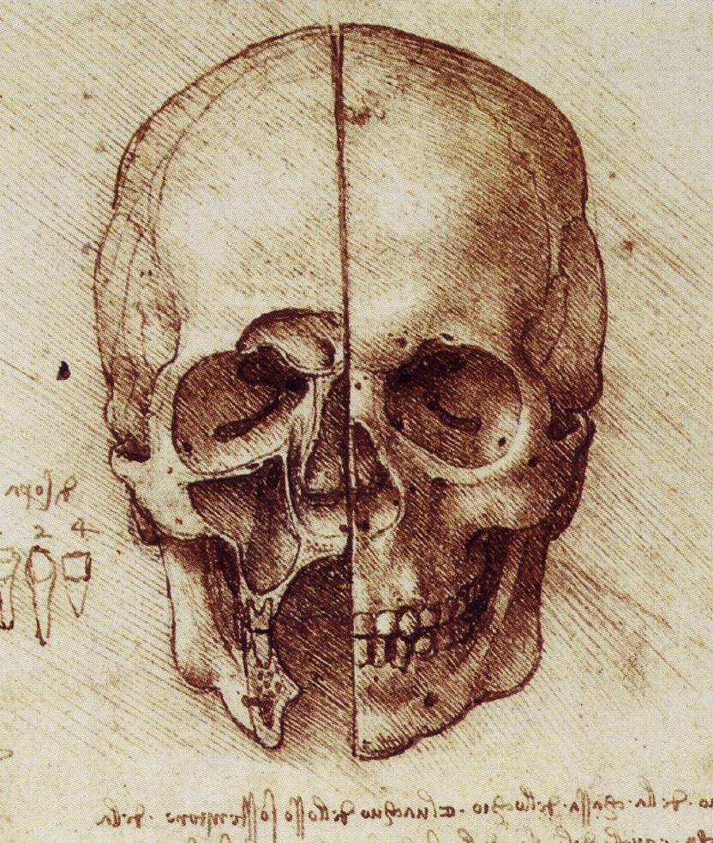

Open Education
Nephtali Marina-Gonzalez
Applied Medical Science
Functional Anatomy and Medical Imaging

Slide 2

Consumer
http://aclandanatomy.com/
https://radiopaedia.org/cases/aneurysmal-subarachnoid-haemorrhage-2
http://www.castlemountain.dk/atlas/objects.php?atlas=AtlasCerebrumCT

Slide 3


Producer
https://youtu.be/qSbTI-AjcdI
https://youtu.be/jyrW_CHGxdk
https://youtu.be/giewPvjVO0E

Slide 4

Showcase portfolio

Slide 5
